Slide 1
Spring Planning Meeting January 27, 2018 Kai Wong
IEEE Central Texas Section Treasurer Report

Slide 2
2018 Chapter Expenses Detail
Chapter Expenses | Adm. Mtg | Tech Mtg | Social Mtg | Train'g Travel | Award, Supp. | Dist. Lecture | Wksp.,Project | Award Dinner | Line 5
Circuits & Sys (CAS / SSC) | 100 | 3500 |  | 1600 |  |  |  |  | 5200
Com/SP-AUS (COM19/SP01-A) | 400 | 840 |  |  | 220 | 500 | 1200 |  | 3160
Com/SP-SA (COM19/SP01-SA) | 130 | 450 |  |  | 170 | 1200 |  | 600 | 2550
EMBS_AUS/CS AUS | 400 | 840 | 270 |  | 270 | 1000 | * CTS |  | 2780
Computer SA (C16-SA) | 160 | 480 |  |  | 100 | 200 |  |  | 940
Consultants' Network-CTCN | 80 | 242 | 200 |  |  |  | 0 |  | 522
CEDA (Design Automation) | 50 | 675 | 75 |  | 100 | 600 |  | 0 | 1500
Electron Devices (ED15) | 50 | 180 |  |  |  | 200 |  |  | 430
Engr Med & Bio (EMB18) SA | 50 | 550 |  |  | 100 |  |  |  | 700
Life-San Antonio | 195 | 160 |  |  | 150 | 600 |  |  | 1105
PI2 (PE31 PEL35 IE13 IA34) | 660 | 700 |  | 4400 | 1100 | 700 | 0 | 1400 | 8960
Product Safety (PSE43) | 420 | 150 | 75 |  |  |  |  |  | 645
SMC/AES (SMC28 / AES10) | 60 | 360 | 300 |  | 400 |  |  |  | 1120
TEM-AUS (TEM14) | 50 | 550 |  |  |  |  |  |  | 600
TEM-SA (TEM14) | 50 | 100 |  |  | 125 |  |  |  | 275
Women In Engrng | 50 | 550 |  |  |  |  |  |  | 600
Young Professionals (Gold) | 100 | 150 | 1250 |  | 354 |  |  |  | 1854
MEMS Sensor (SEN39) | 100 | 750 | 75 |  | 100 | 1200 |  |  | 2225
Chapters total | 3105 | 11227 | 2245 | 4600 | 2689 | 6500 | 1200 | 2000 | 35166

Slide 3
Expenses For Your Approval
Item | 2017 Actual | 2018 Budget | Y-Y Delta
Chapter Operations | 5872 | 13627 | 7755
Chapter Travel/Training | 10167 | 13300 | 3133
Section Operating | 7080 | 12000 | 4920
Section Travel/Training | 18883 | 5500 | -13383
Conference/Workshop | 8123 | 8800 | 677
EMBS Innovation Summit | 3709 | 9000 | 5291
Student Liaison/K-12 | 6186 | 17000 | 10814
Awards | 6030 | 4000 | -2030
Social/Networking | 1317 | 3500 | 2183
IEEE Promotion/Out Reach |  | 3500 | 3500
Loan (Green Tech) | 783 | -783 | 0
Total Expenses | 68150 | 89444 | 22860
Notes:
Notes:

Slide 4
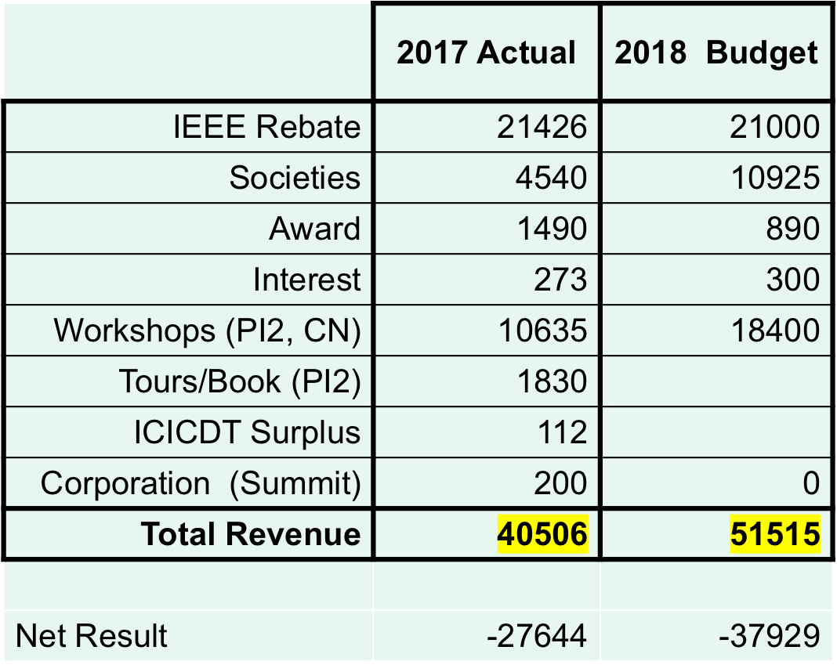
Revenue For Your Approval
Total Expenses | 68150 | 89444
* Joint with CAS/SSC, CEDA, TMC, COMSOC/SP, & WIE
Notes:
Notes: 144 total attendees at Gary’s talk. 109 in auditorium. 42 attendees at workshop. 28 IEEE members. For yr: avg guests 10.5, ieee 14 ¼.

Slide 5
CTS 5 Year Summary
CBRS Record | 2017 | 2016 | 2015 | 2014 | 2013
Opening Balance: | 58495 | 82966 | 33946 | 39271 | 20718
PayPal Gross Activity | 11165 | 8757 | 13978 | 7260 | 20605
Deposits | 1263 | 7312 | 5729 | 6150 | 11490
ACH Deposits |  |  |  | 1000 | 1000
Interest Paid | 273 | 217 | 119 | 115 | 148
Paypal Fees Activity | -266 | -201 | -333 | -158 | -274
IEEE CB Card | -1377 | -2319 | -10403 | -4511 | -4377
Checks Paid | -67025 | -68698 | -54195 | -58370 | -71813
IEEE Transfers | 28932 | 30461 | 94124 | 43189 | 61773
Closing Balance: | 31459 | 58495 | 82966 | 33946 | 39271

Slide 6
CTS 5 Year Investment Reserve
Reserves Analysis | End 2013 | End 2014 | End 2015 | End 2016 | End 2017
Cash Reserves | 35,649 | 32,603 | 68,656 | 30,082 | 31,459
Investment Reserves | 83,310 | 88,069 | 87,782 | 92,557 | 106,439
Total Reserves | 118,959 | 120,672 | 156,438 | 117,864 | 137,898
Reserves Analysis |  | Change | Change | Change | Change
Cash Reserves |  | -3,046 | 36,053 | -38,574 | 1,377
Investment Reserves |  | 4,759 | -286 | 4,775 | 13,882
Total Change |  | 1,713 | 35,767 | -38,574 | 20,034
Notes:
Notes:

Slide 7
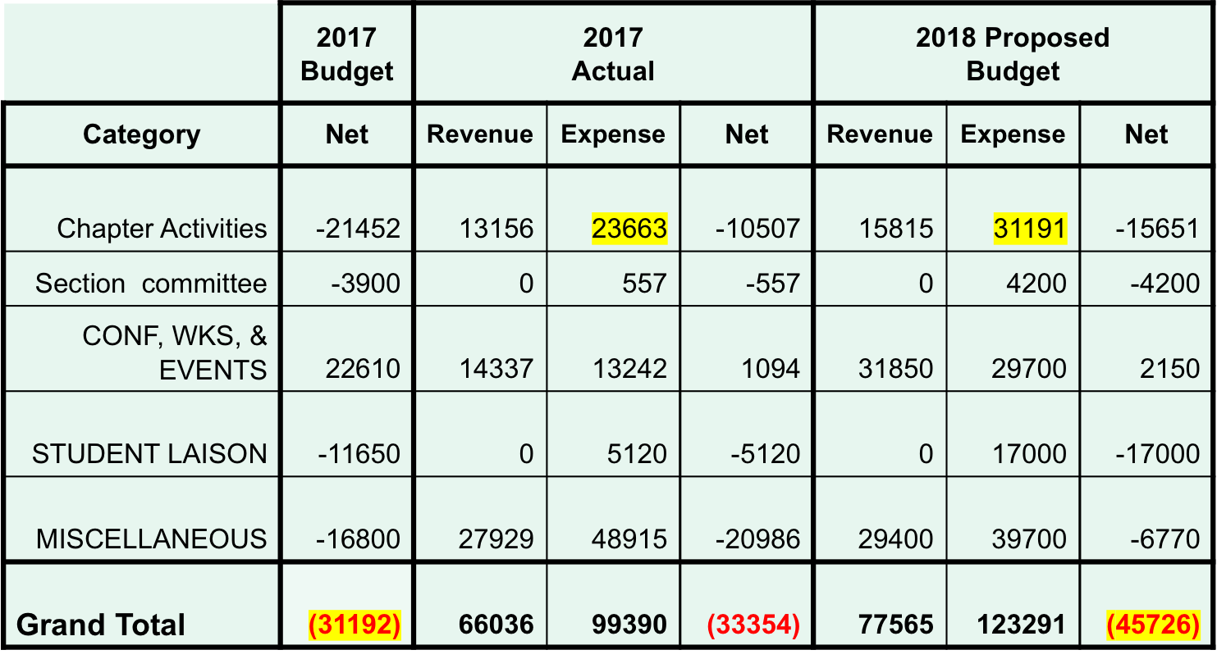
CTS 2017 Actual And 2018 Plan
–
Notes:
Notes:

Slide 8
QUESTIONS??? Thanks
Notes:
If you’d like to learn more about electronic services, you’ll want to attend the session on the Electronic Services being presented this afternoon by Christian Borgert (BORE-GERT) and Chip Dawson. If you miss this afternoon’s session, you can see it tomorrow morning.
Now I’d like to answer your questions about newsletters and electronic services . . .
(After Q&A)
I’m sorry we don’t have time to answer all of your questions, but we have an abundance of expertise with us this weekend, and much of it is in the Computer Lab upstairs. Stop by and get more information anytime.

